Slide 1
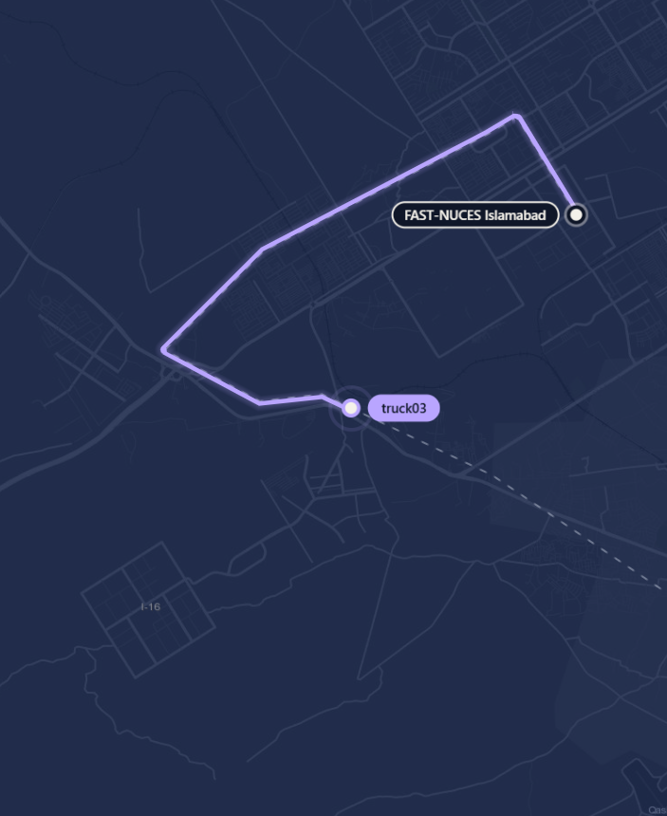
Live Delivery Tracker
PARALLEL AND DISTRIBUTED COMPUTING
Tracking a fleet of trucks with AWS IoT Core and Amazon Location Service
Ahmad Hassan and Hamas Naveed
FAST-NUCES Islamabad
Notes:
P1 (0:30). Assalam-o-Alaikum and good morning everyone. We are [Presenter 1] and [Presenter 2]. Today we will show you how to track a whole fleet of delivery trucks live on a map, using two AWS services: AWS IoT Core and Amazon Location Service. I will cover the problem, the design and AWS IoT Core. [Presenter 2] will cover Amazon Location Service and security, and then we build it in the AWS console in front of you and run it live.

Slide 2
Where is my delivery right now?
THE PROBLEM
1
2
3
Every vehicle reports
Every position is kept
Every answer is live
A position every second, over mobile networks that drop out.
The whole trip is stored, not only the last point.
Thousands of vehicles, all at the same time.
We built it for four trucks with managed AWS services, and no tracking servers of our own.
Notes:
P1 (0:55). Think about the last time you ordered food or booked a ride. The first thing you check is: where is it right now? Behind that little moving icon is a hard problem. Every vehicle has to report its position every few seconds over unreliable mobile networks. Every position has to be stored. And the answer has to be live, for thousands of vehicles at the same time. Building that yourself means servers, databases and a lot of scaling work. So we built it with managed AWS services instead: four delivery trucks leave FAST-NUCES for four places in Islamabad and Rawalpindi, each reports its position once a second, and one live map shows all of them, with what each truck is carrying. We run no tracking servers of our own. You will see it running at the end.

Slide 3
How the data flows
ARCHITECTURE
1
2
3
4
5
Trucks
IoT Core
IoT rule
Tracker
Live map
4 simulated GPS devices
MQTT over TLS
Forwards each message
Position history
Redraws every 2 s
truck_simulator.py
trucks/location
SELECT *
DeliveryTracker
localhost:8000
AWS IoT Core
Amazon Location Service
No part talks directly to another. Each one only hands data to the cloud.
Notes:
P1 (1:10). Here is the whole system. Our trucks are a Python program pretending to be GPS devices. Once a second each truck sends its location to AWS IoT Core, on a topic called trucks/location. An IoT rule picks up every message and forwards it to an Amazon Location tracker, which stores each truck's position history. Finally the live map reads that history every two seconds and draws the routes. Notice that no part talks directly to another: the truck does not know the tracker exists, and the map never hears from a truck. Each piece only hands data to the cloud. The orange parts are AWS IoT Core, which I will explain. The teal parts are Amazon Location Service, which [Presenter 2] will explain.

Slide 4
Every device proves who it is
AWS IOT CORE
A
Thing
demo/certs/
The device's entry in the registry. Ours is truck01.
truck01.cert.pem
The certificate. Safe to share.
B
X.509 certificate
Proves the device's identity. No passwords, and the private key never leaves the device.
truck01.private.key
The secret. Never upload it.
C
Device policy
AmazonRootCA1.pem
Attached to the certificate. Lists exactly what the device may do.
Lets the truck verify AWS.
Notes:
P1 (1:05). AWS IoT Core is a managed service that connects devices to the cloud. It starts with identity. Every device is registered as a 'thing'. Ours is truck01. The thing gets its own X.509 certificate, so it proves who it is without any password. The private key stays on the device and never leaves it. Then a device policy is attached to the certificate, and it says exactly what this device may do. On the right are the three files a real device carries: its certificate, its private key, and Amazon's root certificate so the device can check it is really talking to AWS. We will create all of this in the console in a few minutes.

Slide 5
MQTT: publish and subscribe
AWS IOT CORE
Subscriber
IoT rule
Publisher
Topic on IoT Core
Each truck
trucks/location
Subscriber
MQTT test client
Lightweight
QoS 1
TLS, port 8883
A 2-byte header, made for weak networks.
At-least-once: unacknowledged messages are sent again.
Every message is encrypted in transit.
Notes:
P1 (1:00). Devices talk to IoT Core using MQTT, a lightweight publish/subscribe protocol designed for weak mobile networks. It works like a notice board. A device publishes a message to a topic, here trucks/location. It does not send it to anyone in particular. Anyone interested subscribes to that topic and receives a copy. Today there are two subscribers: our IoT rule, and the MQTT test client in the console that we will use to watch messages arrive. Three details matter. The header is tiny, so it suits slow networks. We use quality of service 1, which means at-least-once delivery: an unacknowledged message is sent again. And everything travels over TLS on port 8883. One thing that surprised us: a brand-new IoT endpoint's address did not exist for several minutes, because new DNS names take time to spread.

Slide 6
One message, one rule
AWS IOT CORE
What a truck publishes
The rule that forwards it
{
"deviceId": "truck02",
"latitude": 33.67827,
"longitude": 73.01601,
"timestamp": "2026-11-11T15:16:42Z"
}
SELECT * FROM 'trucks/location'
Action | Location
Tracker name | DeliveryTracker
Device ID | ${deviceId}
Latitude | ${latitude}
Longitude | ${longitude}
Timestamp | ${timestamp()}
Failures are republished to errors/trucks, so a broken rule is easy to spot.
Notes:
P1 (1:05). This is the actual message a truck publishes: a device ID, latitude, longitude and a timestamp, in plain JSON. On the right is our rule. It is one line of SQL: select everything from the topic trucks/location. Its action is Amazon Location. It takes deviceId, latitude and longitude out of each message and writes them into our tracker, DeliveryTracker. The dollar-and-braces values are substitution templates: IoT Core fills them in from each message. If the rule ever fails, the error is republished to a separate topic, errors/trucks, so we can debug it. That is the IoT Core side. Now [Presenter 2] will show you where the data goes.

Slide 7
Positions in, places out
AMAZON LOCATION SERVICE
Trackers
Routes
Maps
Store every device's position history. One tracker, many devices, each kept under its own device ID.
Work out real road routes. Each truck asks for the road from the depot to its drop-off.
Supply the map tiles through an API key that can do nothing else.
DeliveryTracker
CalculateRoutes
GetTile
Next step: geofences. An alert when a truck enters or leaves an area, such as the customer's street.
Notes:
P2 (1:00). Thank you, [Presenter 1]. Amazon Location Service adds maps and location features to applications. We used three of its parts. Trackers store each device's position history. One tracker holds many devices, and each device's history is kept separately under its device ID. Routes calculates real road routes. Every truck asks it for the road route from FAST to its destination, so the trucks follow real roads instead of straight lines. And Maps can supply the map itself, through an API key that is only allowed to load map tiles, and only from our dashboard. A fourth feature, geofences, could alert us when a truck enters or leaves an area, like the customer's street. That is our next step.

Slide 8
Which positions are worth keeping?
AMAZON LOCATION SERVICE
Time-based
Distance-based
Keeps one position per device every 30 seconds.
Ignores any move shorter than 30 m. Our trucks move 80 m per update.
The truck jumps across the map
A smooth trail, and no GPS jitter
You pay per stored position, so the filter also decides the bill.
Notes:
P2 (0:55). A tracker does not have to store every position it receives. You choose a filter when you create it. Time-based filtering keeps one position per device every 30 seconds. We tried that first, and our truck jumped across the map. Distance-based filtering ignores any move shorter than 30 metres. That removes GPS jitter from a parked vehicle, and it costs less, because you pay per stored position. Our trucks move 80 metres per update, so every update is kept and the trail is smooth. This one setting is the difference between a broken demo and a working one.

Slide 9
From one truck to a fleet
WHY THIS IS PDC
 | Truck | Going to | Carrying | Load | Road
 | truck01 | Faisal Mosque | Mosque supplies | 486 kg | 11.6 km
 | truck02 | PIMS Hospital | Medical supplies, cold chain | 1,080 kg | 8.2 km
 | truck03 | Saddar, Rawalpindi | Groceries | 3,560 kg | 22.3 km
 | truck04 | Centaurus Mall | Electronics | 666 kg | 8.7 km
Decoupled
Parallel
Reliable
Same topic, rule and tracker. Only the deviceId changes.
One thread per truck. The map reads all four histories at once.
QoS 1: at-least-once delivery, over TLS.
Notes:
P2 (1:10). Our first version tracked one truck. Going to four needed no change at all in AWS. Every truck publishes to the same topic, passes through the same rule, and lands in the same tracker. The only thing that differs is the deviceId inside the message, and the tracker keeps a separate history for each ID. The cargo and delivery details here are each truck's delivery sheet, which the map shows next to its live position. And this is why it belongs in a Parallel and Distributed Computing course. It is decoupled: with publish/subscribe a truck never knows the tracker exists, so we can add a new consumer, like an SMS alert, without touching the trucks. It runs in parallel: the simulator runs one thread per truck, and the dashboard reads all four histories at once. The same setup works for four thousand, because AWS scales out for us. And it is reliable: MQTT quality of service 1 gives at-least-once delivery, over an encrypted connection.

Slide 10
Three identities, three small policies
SECURITY
The truck
Our laptop
The IoT rule
truck01-policy, on its certificate
pdc-demo-policy, on an IAM user
iot-location-role, an IAM role
iot:Connect
client/truck01
iot:Publish
topic/trucks/location
iot:DescribeEndpoint
iot:Publish (one topic)
geo:GetDevicePositionHistory
geo:BatchDeleteDevicePositionHistory
geo-routes:CalculateRoutes
geo:BatchUpdateDevicePosition
tracker/DeliveryTracker
If one identity is stolen, the damage stops at its own policy.
Notes:
P2 (1:10). Three different identities touch this system, and each one gets the smallest policy that works. That is the principle of least privilege. The truck, through its certificate, may connect only as truck01 and publish only to trucks/location. It cannot subscribe, and it cannot read anything. Our laptop, as the IAM user pdc-demo-user, may find the IoT endpoint, publish to that one topic, read and reset that one tracker, and calculate routes. Nothing else in the account. And the IoT rule runs with its own role, which may only write positions into that one tracker. If any one of these is stolen, the damage stops there. We learned this the hard way: one wrong account ID in an ARN gives you 'access denied' with very little explanation. We will show you each policy in the console.

Slide 11
Build it, then run it
NEXT: THE AWS CONSOLE, THEN THE DEMO
1
2
3
4
5
Tracker
IoT rule
Thing
IAM user
Test by hand
Amazon Location
IoT Core
IoT Core
IAM
MQTT test client
DeliveryTracker, distance-based
truck_location_rule and its role
truck01, certificate, policy
pdc-demo-user and its policy
Publish one message
Then the live demo, from the demo folder
What to watch
1
Messages arriving in the MQTT test client
# 1. the map: http://localhost:8000
py dashboard.py
# 2. the trucks
py truck_simulator.py --mode mqtt
2
Trails read back from the tracker
3
Choose trucks, open a delivery sheet
Notes:
P2 (0:45). That is the theory. Now we switch to the AWS console and show you how each piece is set up, in this order. I create the tracker. [Presenter 1] shows the IoT rule, then the thing with its certificate and policy. I show the IAM user and its policy. Then we test the pipeline by hand in the MQTT test client, before any code runs. Everything is in one region, us-east-1. After that, the live demo: two commands, and you watch the messages arrive and the four trucks drive. (Switch to the browser now. The step-by-step is in PRESENTATION_FLOW.md. If the demo fails, play Demo_video_PDC.mp4.)

Slide 12
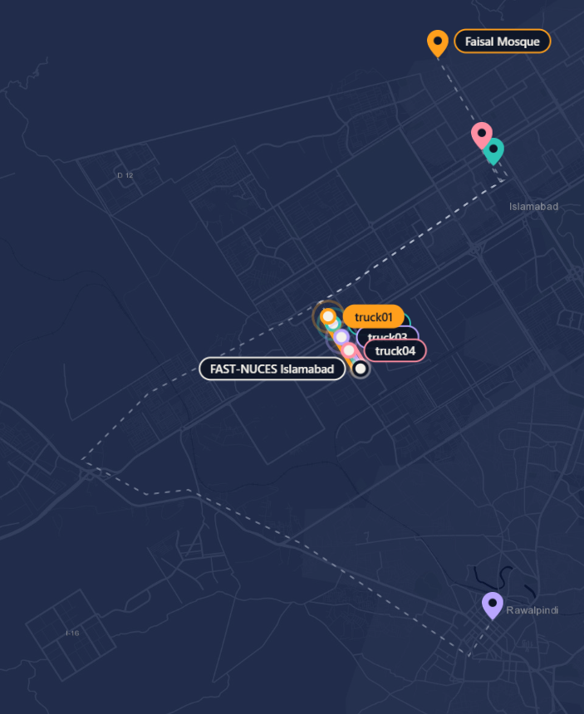
Thank you
DELIVERED
AWS IoT Core gets device data into the cloud securely. Amazon Location Service turns it into places on a map.
Questions?
github.com/AhmadHassanSE/PDC_Project
Notes:
P2 (0:30, back on the map first). And our trucks have arrived. To sum up: AWS IoT Core gets device data into the cloud securely, and Amazon Location Service turns it into places on a map. Together, with no servers of our own, they make a live tracking system for one truck or a whole fleet. Thank you. We are happy to take your questions.

